Slide 1
BTT Recorder v1.2.4
Installing

Slide 2
There are three ways to get the Installation Software:
One – download from the Bible Translation Tools site
Two - download from the Repository
Three – download from Google Play Store
* These 3 ways are listed in order of ease of access and process.

Slide 3
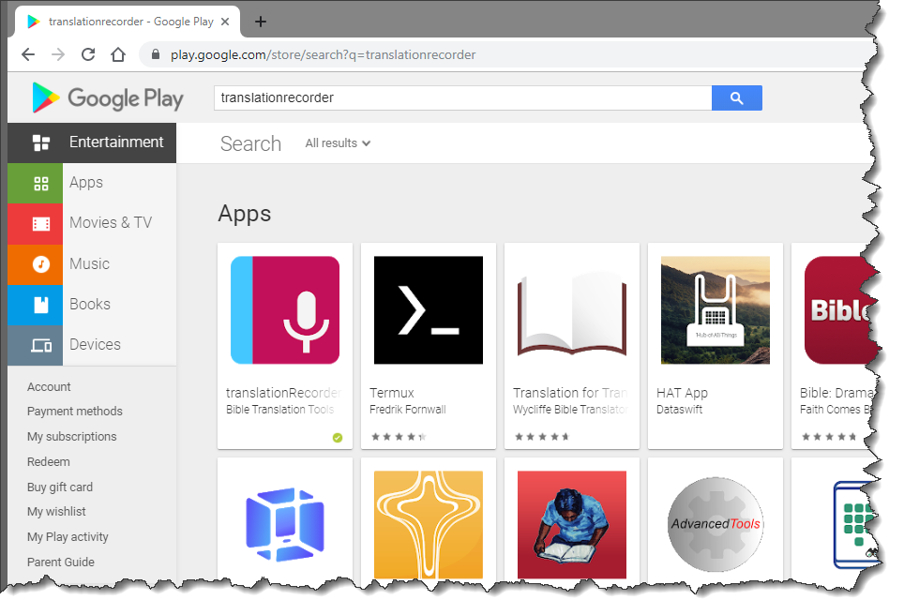
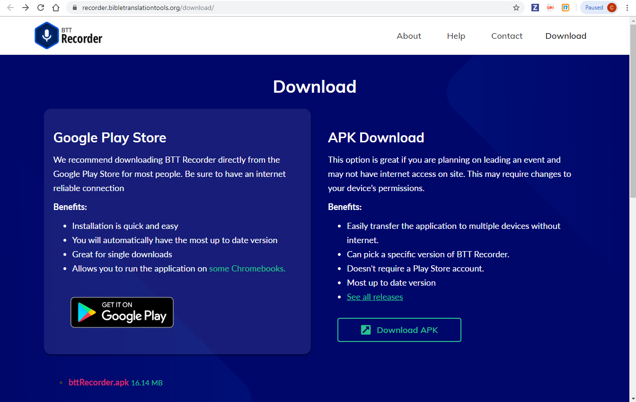
From the BTT site
Downloading Software:
Go to https://recorder.bibletranslationtools.org/download/.
Click on the Download APK link.
Let the file download to the Android device.

Slide 4
From the BTT site
Installing Software:
Navigate to the download folder.
Tap on the bttRecorder.apk file and allow the program to install. (You may need to give permission for an APK to install on the device.)

Slide 5
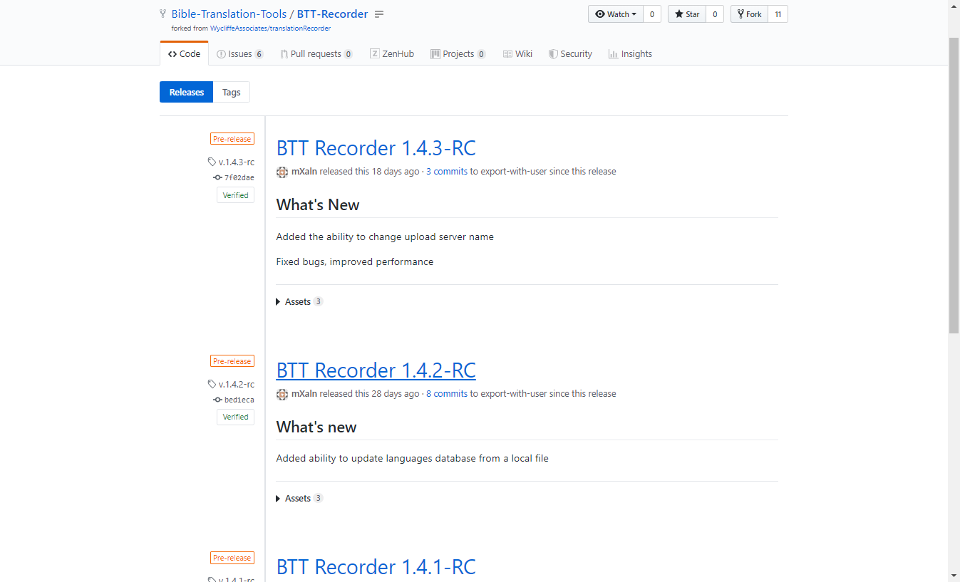
From the Repository
Downloading Software:
Go to https://github.com/Bible-Translation-Tools/BTT-Recorder/releases.
Tap on the first listed release (the large blue words and letters). The list of files that can be downloaded shows.

Slide 6
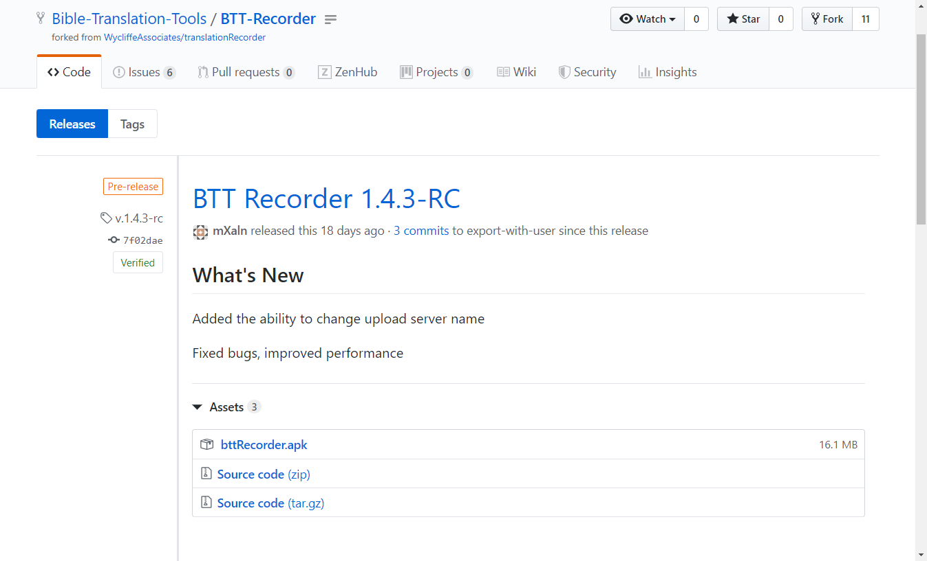

From the Repository
Downloading Software:
You may need to click to open the list of Assets
Tap on the bttRecorder.apk link.
The APK file downloads.

Slide 7
From the Repository
Installing Software:
Navigate to the download folder.
Tap on the bttRecorder.apk file and allow the program to install. (You may need to give permission for an APK to install on the device.)

Slide 8
From Google Play Store
Downloading Software:
Open Google Play Store on the Android device.
Type in ‘translationrecorder’ in the search field.
Click on the translationRecorder icon.

Slide 9
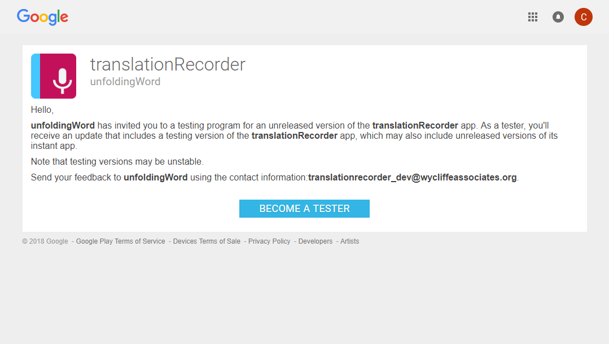
From Google Play Store
Downloading Software:
The browser opens to the install page.
Tap the ‘Become a Tester’ blue button to become a tester.

Slide 10
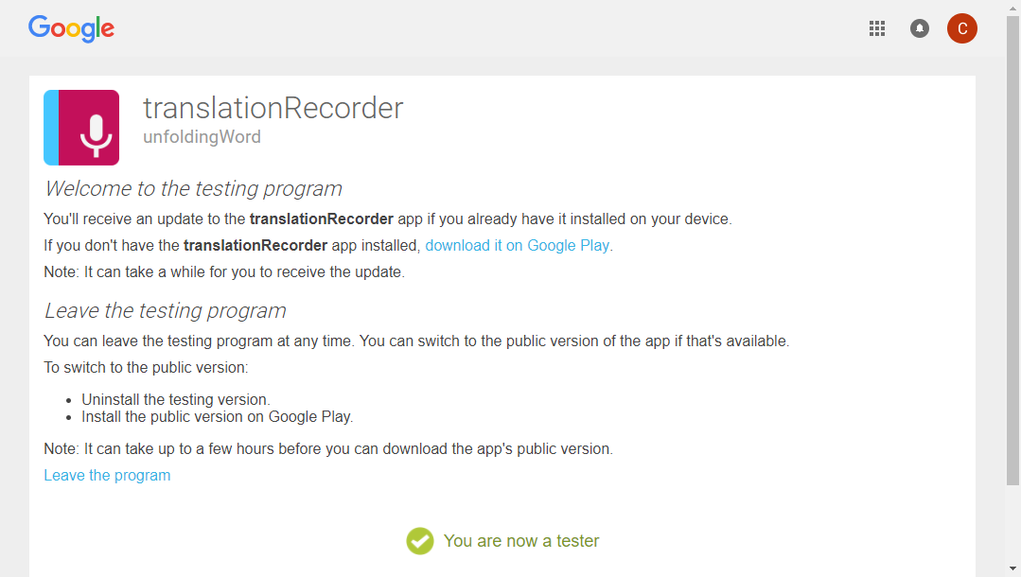
From Google Play Store
Downloading Software:
The notice that ‘You are now a tester’ appears.
Tap the link to ‘download it on Google Play.’

Slide 11
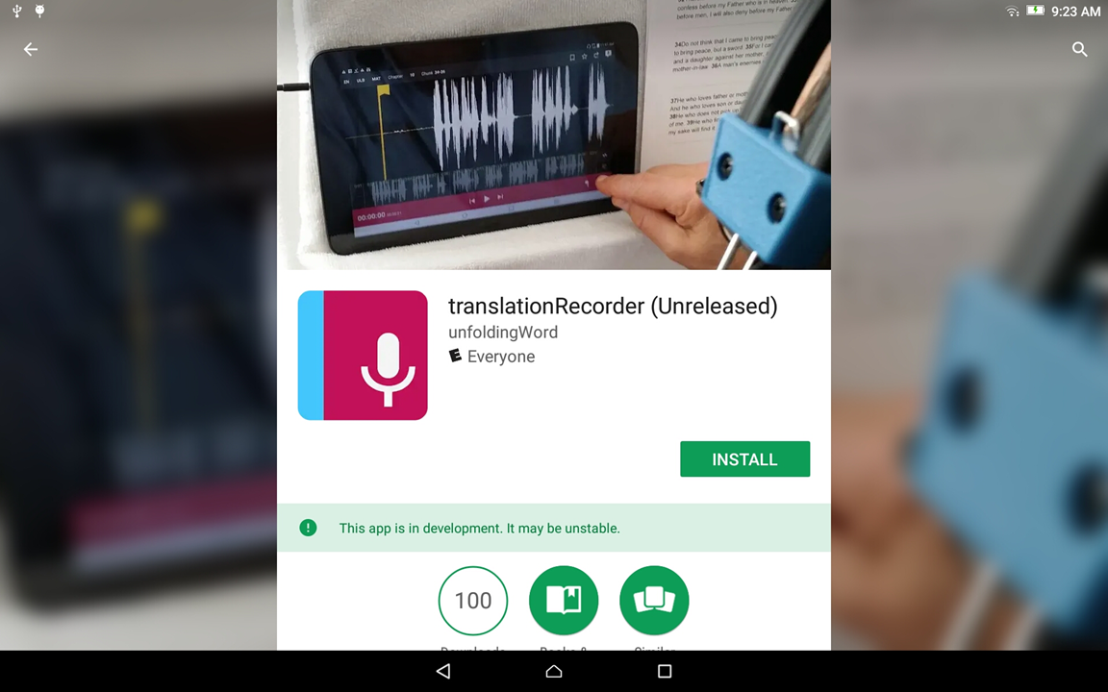
From Google Play Store
Installing software:
Tap the ‘Install’ green button to start installing the software.

Slide 12
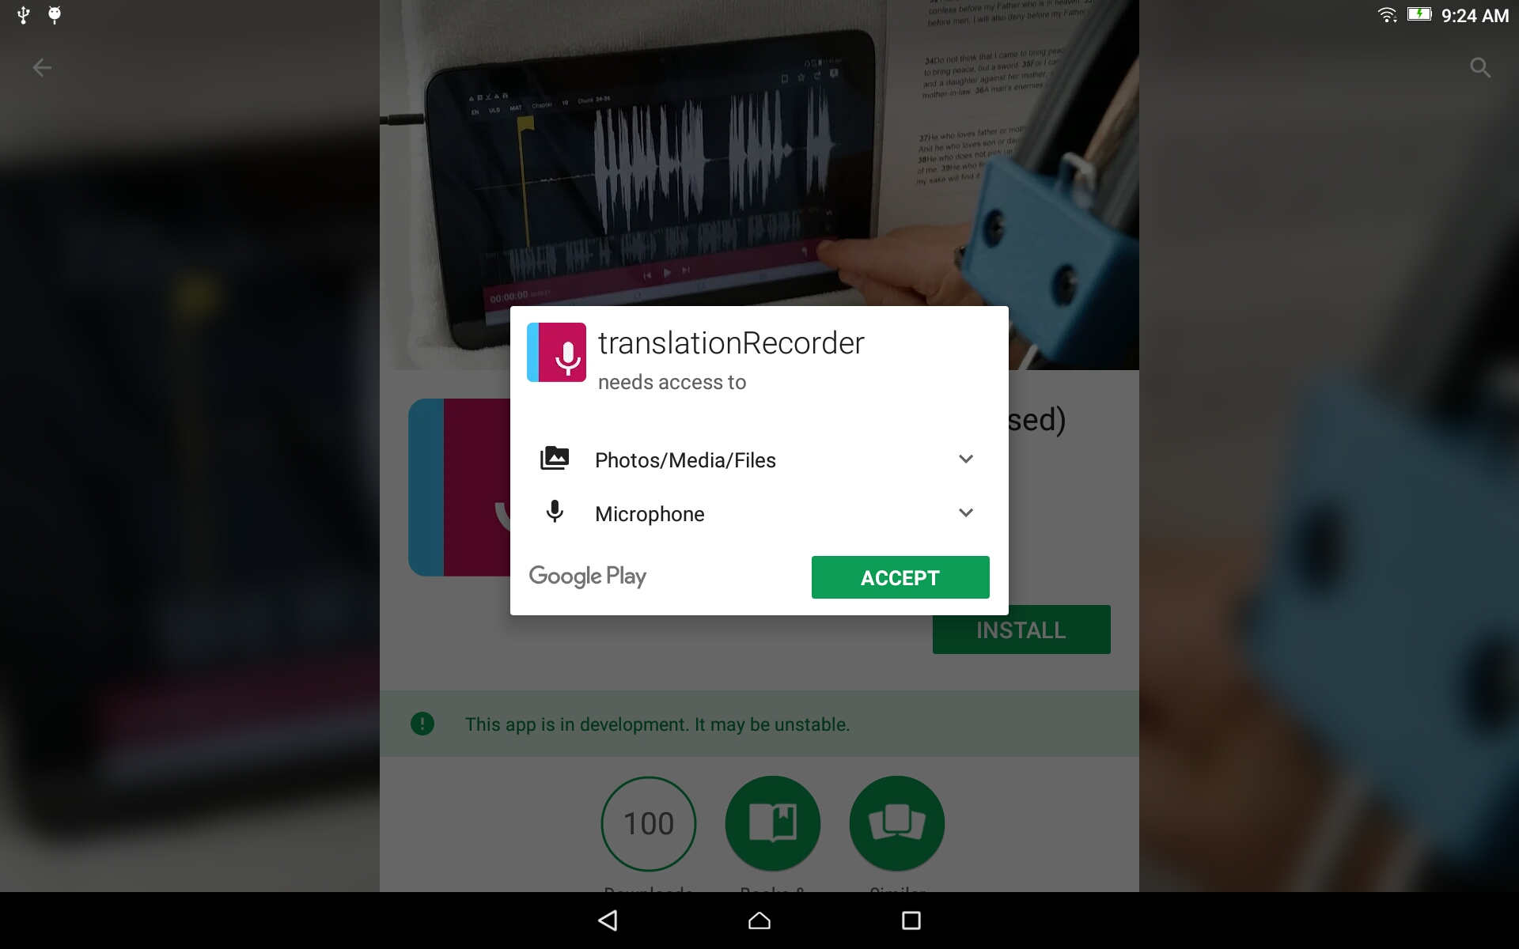
From Google Play Store
Installing software:
Accept the software’s permission to access the microphone by tapping on the green ‘Accept’ button.

Slide 13
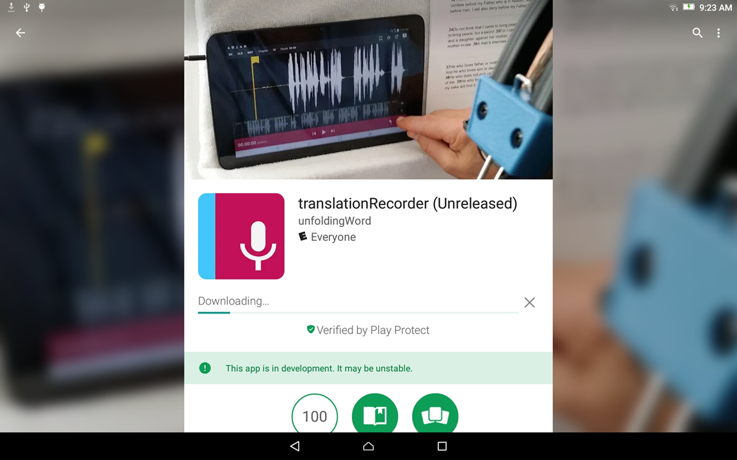
From Google Play Store
Installing software:
Wait while the software downloads and installs.

Slide 14
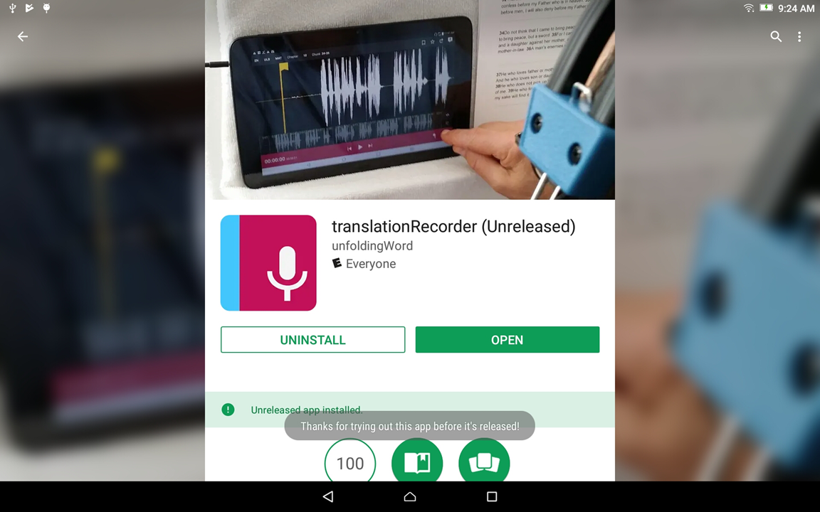
From Google Play Store
Installing software:
Tap the ‘Open’ green button to open the program.

Slide 15
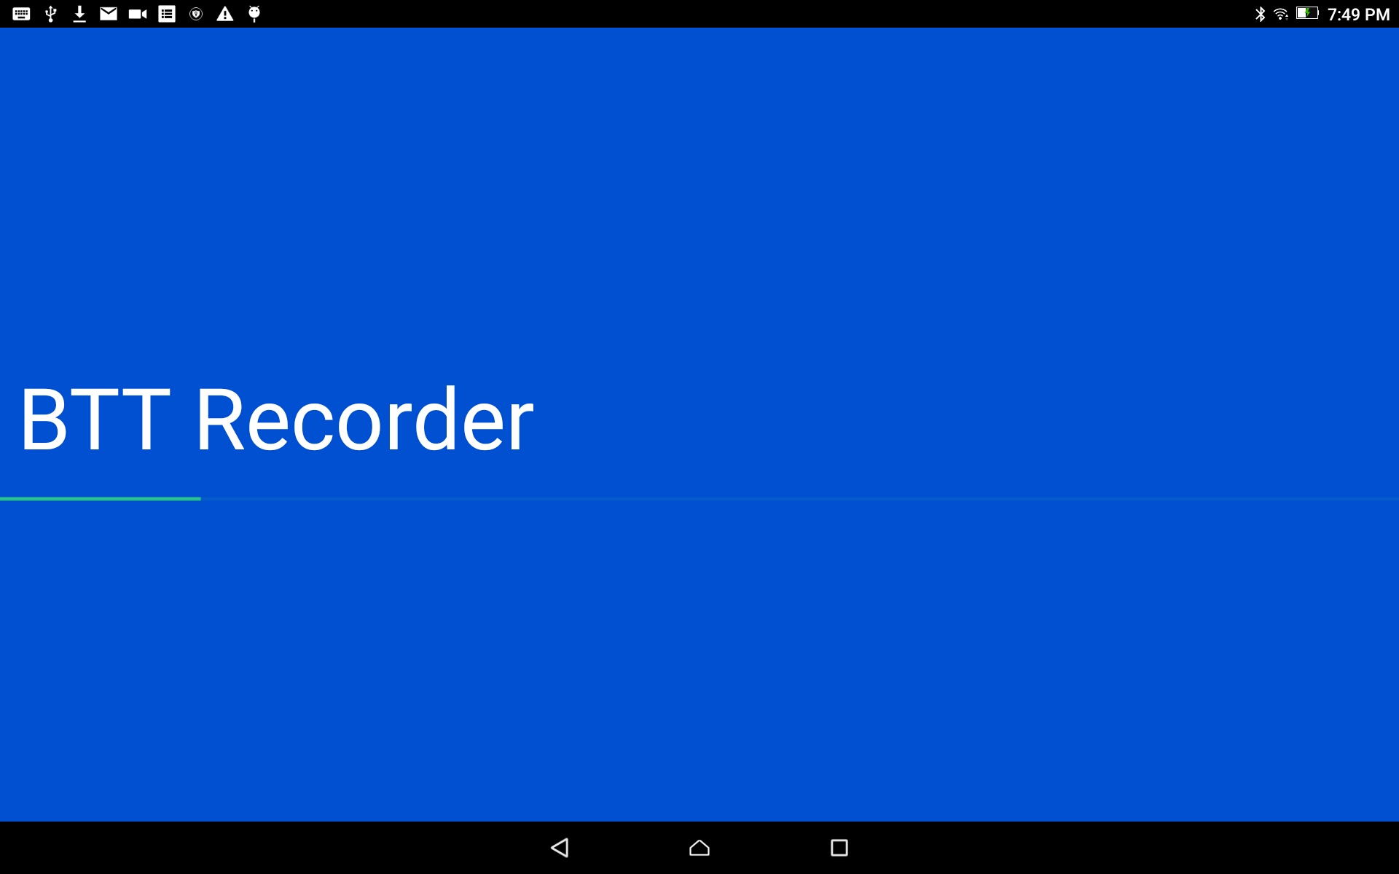
BTT Recorder Installed
Bible Translation Tool Recorder is opening.

